Slide 1
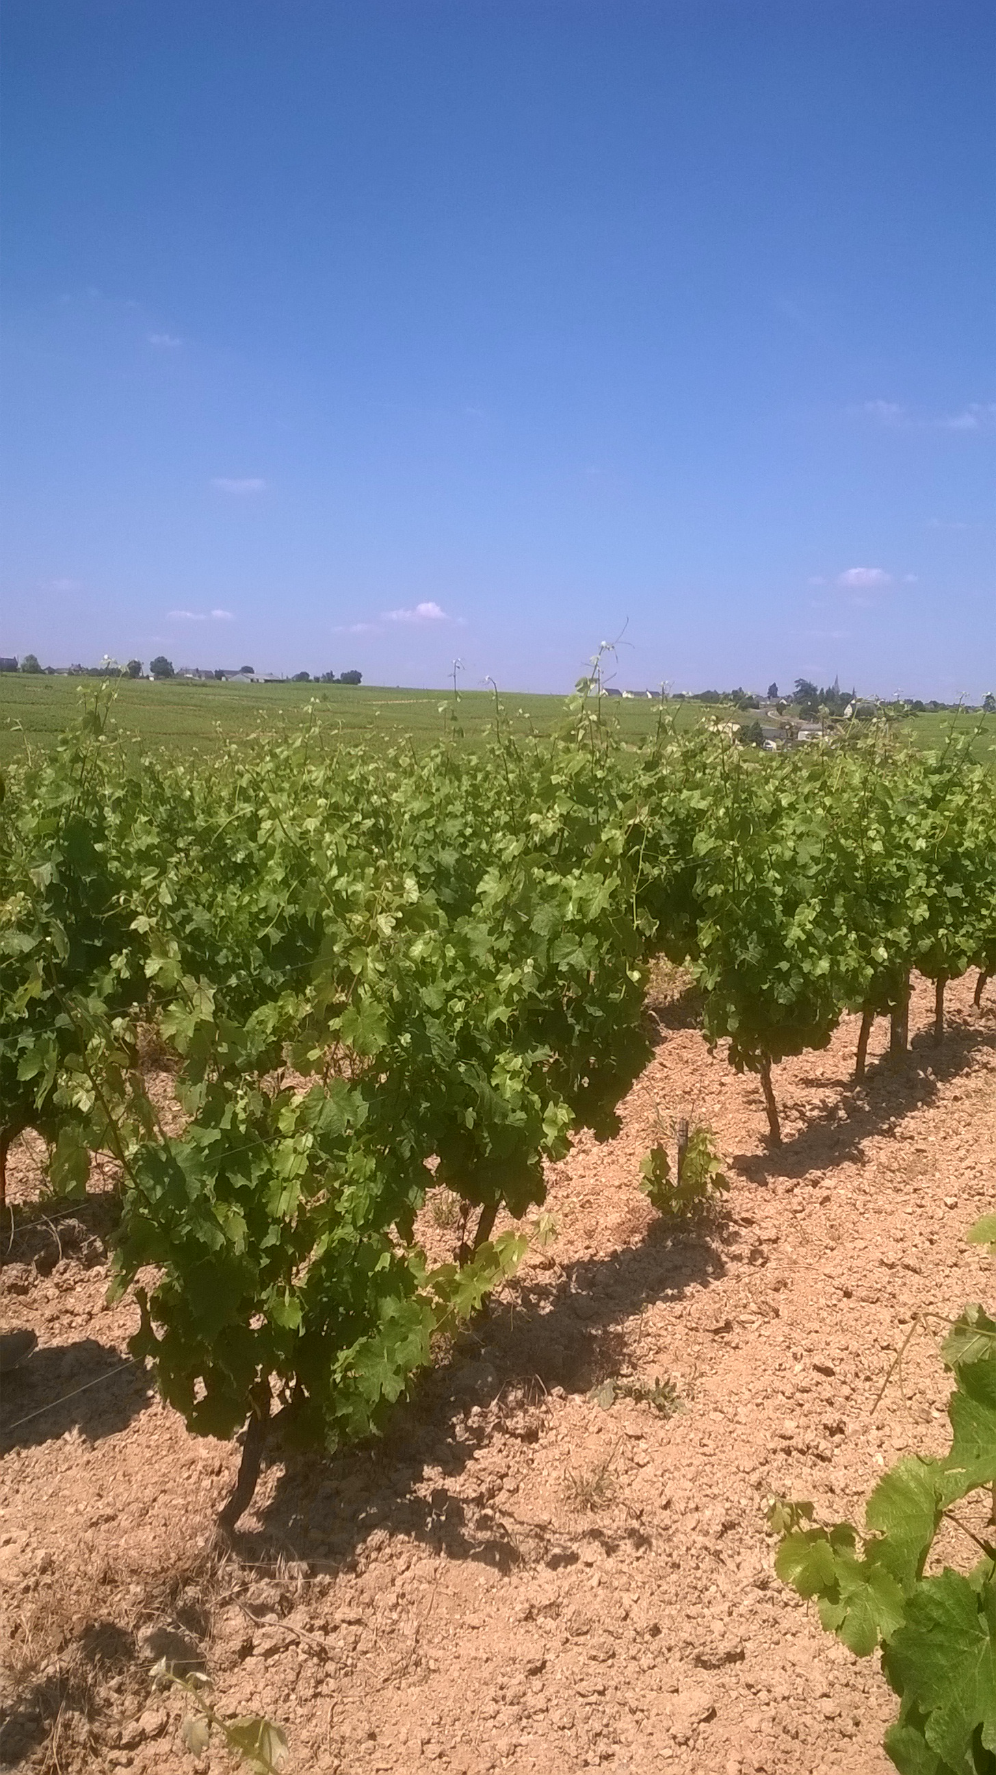
Chenin Blanc ripening dynamics in Anjou: focus on the 5 last vintages through berry active sugar loading Harvest position and wine profile
CHENIN BLANC INTERNATIONAL CONGRESS
Nicolas BERNARD
Angers, 2 Juillet 2019

Slide 2
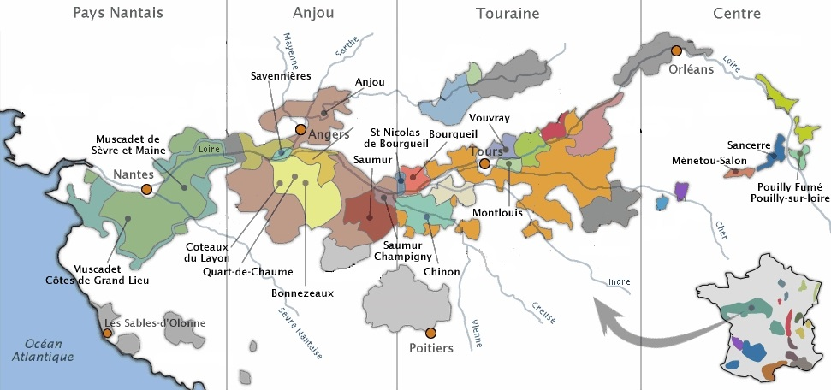
SINCE 2014, 45 BLOCKS OF CHENIN BLANC LOCATED IN ANJOU

Slide 3
A COLLECTIVE PROJECT OF DEVELOPMENT
➔ To describe the ripening behaviors of the Chenin Blanc in Anjou
➔ To understand the relationship between
- Ripening behavior
- Position of the picking date
- Wine profile

Slide 4
berry active sugar loading
The evolution of the sugar quantity per berry during ripening is a integrative physiological parameter, resulting from the behavior of the vine in its terroir. It mainly depends on:
Photosynthesis activity
➔ Climate
➔ Vine water status
➔ Vine nutrition
Vine balance
➔ Yield
➔ Leaf Area
(McCarthy & Coombe, 1999 / Wang et al., 2003 / Hunter & Deloire, 2005)

Slide 5
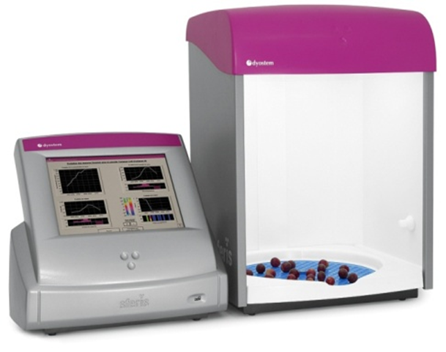
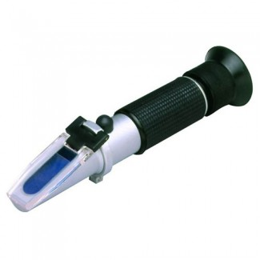
berry active sugar loading
Sugar quantity per berry
mg
=
Sugar concentration
of the juice
g/L
Х
Berry average volume
mL

Slide 6
berry active sugar loading
Sugar quantity per berry
(mg/berry)
Active sugar loading period
No more active sugar loading
Véraison
End of sugar loading

Slide 7
the 5 data of berry active sugar loading
Maximum sugar quantity per berry
3
Sugar quantity per berry
(mg/berry)
2
Rate of loading
Potential Degree
(or Brix) at the end
of sugar loading
5
1
Duration of sugar loading
4
Date of the end
of sugar loading

Slide 8
the CHENIN BLANC berry sugar loading in ANJOU
 | Average values for Chenin Blanc (45 blocks per vintage, 5 vintages)
Duration of sugar loading | 36 days
Rate of loading during the first phase | 7,6 mg/berry/day
Maximum sugar quantity per berry | 316 mg/berry
Average date of sugar loading end | Sept-18
Potential Degree at the end of sugar loading | 12,1 %vol.

Slide 9
the CHENIN BLANC berry sugar loading in ANJOU
 | Average values for Chenin Blanc (45 blocks per vintage, 5 vintages)
Duration of sugar loading | 36 days
Rate of loading during the first phase | 7,6 mg/berry/day
Maximum sugar quantity per berry | 316 mg/berry
Average date of sugar loading end | Sept-18
Potential Degree at the end of sugar loading | 12,1 %vol.

Slide 10
the CHENIN BLANC berry sugar loading in ANJOU
 | Average values for Chenin Blanc (45 blocks per vintage, 5 vintages)
Duration of sugar loading | 36 days
Rate of loading during the first phase | 7,6 mg/berry/day
Maximum sugar quantity per berry | 316 mg/berry
Average date of sugar loading end | Sept-18
Potential Degree at the end of sugar loading | 12,1 %vol.
VINTAGE EFFECT ?

Slide 11
vintage effect on Chenin blanc sugar loading in Anjou
Potential degree
at the end of sugar loading
(%vol.)
Date of the end of sugar loading

Slide 12
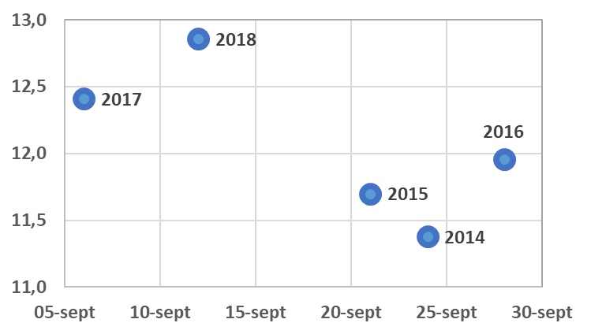
vintage effect on Chenin blanc sugar loading in Anjou
Potential degree
at the end of sugar loading
(%vol.)
Average
5 years
Date of the end of sugar loading

Slide 13
vintage effect on Chenin blanc sugar loading in Anjou
Potential degree
at the end of sugar loading
(%vol.)
1,5 %vol
Average
5 years
22 days
Date of the end of sugar loading

Slide 14
vintage effect on Chenin blanc sugar loading in Anjou
Potential degree
at the end of sugar loading
(%vol.)
WHAT CAN EXPLAIN THAT VINTAGE EFFECT ?
1,5 %vol
Average
5 years
22 days
Date of the end of sugar loading

Slide 15
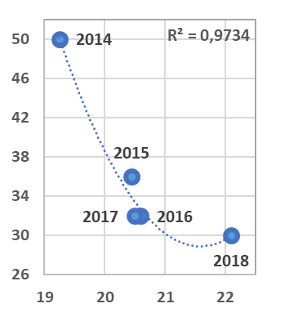
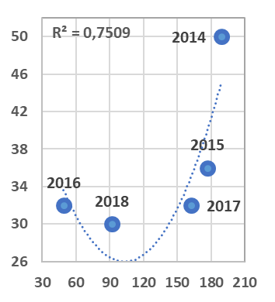
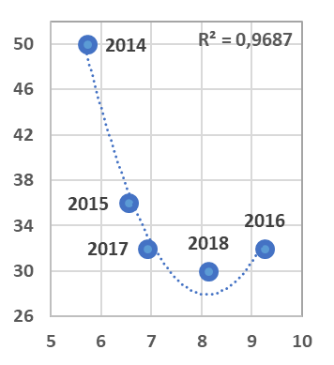
duration of sugar loading & climate
Duration of sugar loading (day)
Average summer temperature
(°C)
Total rainfall
during summer (mm)
Average daily
hours of sun
during summer (h)

Slide 16
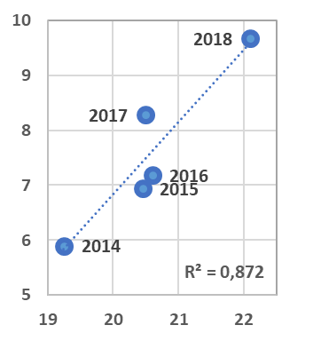
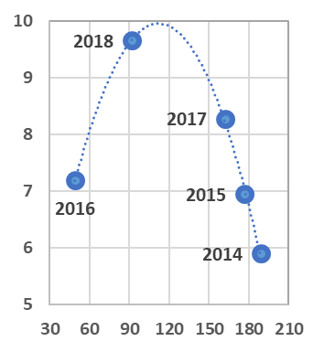
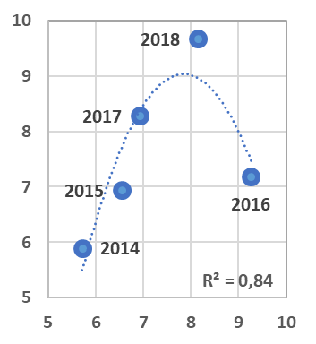
rate of sugar loading & climate
Rate of sugar loading
(mg/berry/day)
Average summer temperature
(°C)
Total rainfall
during summer (mm)
Average daily
hours of sun
during summer (h)

Slide 17
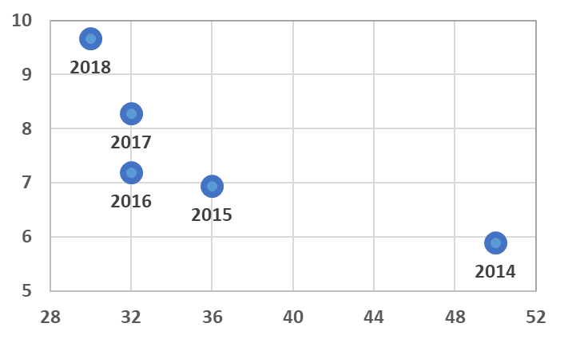
vintage effect on rate & duration of sugar loading
Rate of sugar loading
(mg/berry/day)
INCREASING TEMPERATURE
Duration of sugar loading (day)

Slide 18
vintage effect on rate & duration of sugar loading
Rate of sugar loading
(mg/berry/day)
INCREASING PRECIPITATIONS
Duration of sugar loading (day)

Slide 19
vintage effect on rate & duration of sugar loading
Rate of sugar loading
(mg/berry/day)
INCREASING RADIATIONS
Duration of sugar loading (day)

Slide 20
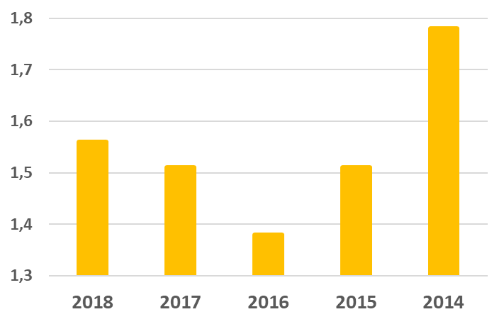
vintage effect on Chenin blanc berry volume in Anjou
Average
berry volume
(Volume max
in mL)
Average 5 years
=
1,55 mL

Slide 21
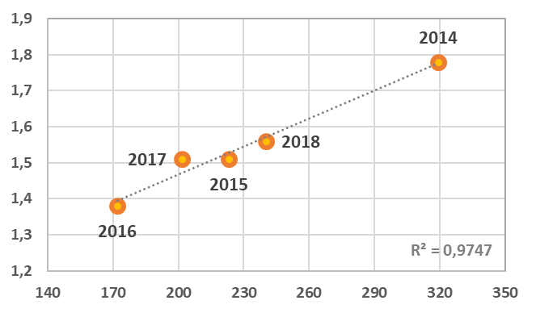
vintage effect on Chenin blanc berry volume in Anjou
Average
berry volume
(Volume max
in mL)
Total rainfall from May to August (mm)

Slide 22
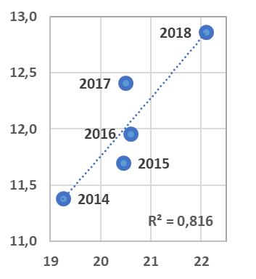
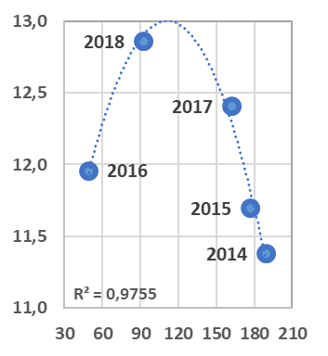
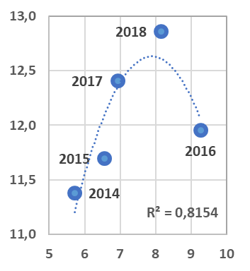
Potential degree at the end of sugar loading & climate
Potential degree at the end
of sugar loading (%vol.)
Average summer temperature
(°C)
Total rainfall
during summer (mm)
Average daily
hours of sun
during summer (h)

Slide 23
berry sugar loading & climate CONCLUSIONS
TEMPERATURE
Higher temperature (22°C) ➔ higher potential degree at sugar loading stop
No thermal stress effect identified (≠ Burgundy 2018)
WATER
Moderate water restriction ➔ higher potential degree at sugar loading stop
Water stress or Excess of water ➔ lower potential degree at sugar loading stop
RADIATIONS
Higher radiations ➔ higher potential degree at sugar loading stop
But > 9 hours of sun / day (2016) ➔ lower potential degree at sugar loading stop

Slide 24
comparing with Chenin blanc in South Africa
 | ANJOU | SOUTH AFRICA
Duration of sugar loading | 36 days | 28 days
Rate of loading during the first phase | 7,6 mg/berry/day | 11,1 mg/berry/day
Maximum sugar quantity per berry | 316 mg/berry | 370 mg/berry
Average date of sugar loading end | Sept-18 | Feb-1
Potential Degree at the end of sugar loading | 12,1 %vol. | 13,5 %vol.

Slide 25
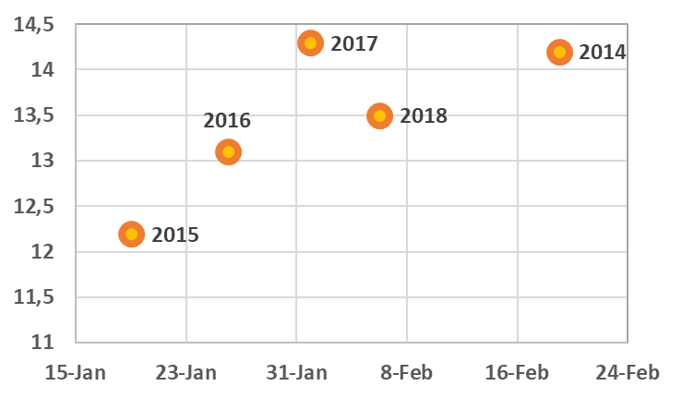
comparing with Chenin blanc in South Africa (Paarl)
Potential degree
at the end of sugar loading
(%vol.)
Date of the end of sugar loading

Slide 26
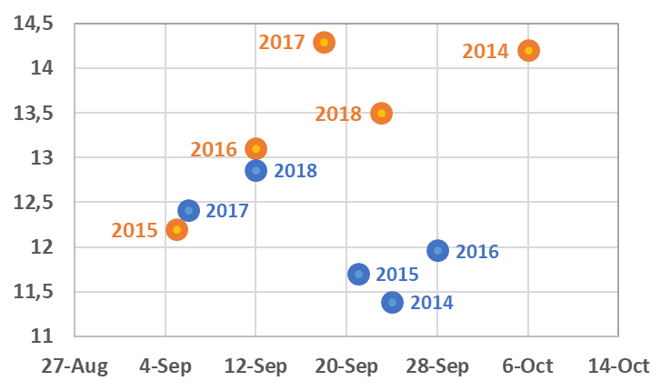
comparing with Chenin blanc in South Africa (Paarl)
Potential degree
at the end of sugar loading
(%vol.)
Date of the end of sugar loading

Slide 27
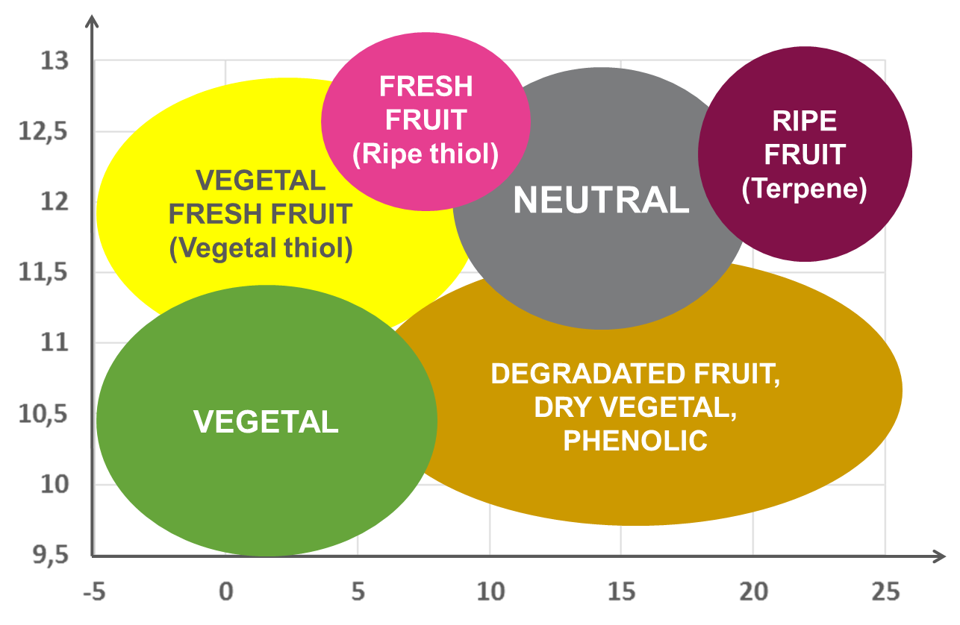
sugar loading, position of harvest & wine profile
Potential degree
at the end of sugar loading
(%vol.)
Position of harvest
(number of days after the end of sugar loading)

Slide 28
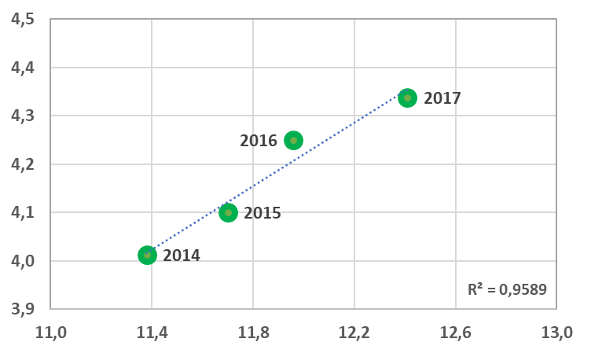
sugar loading and wine quality
Vintage average quality grade
( / 5 )
Le Figaro
Le Point
Wine Spectator
Wine Enthousiast
Potential degree at the end of sugar loading (%vol.)

Slide 29
sugar loading and wine quality
2018 ?
Vintage average quality grade
( / 5 )
Le Figaro
Le Point
Wine Spectator
Wine Enthousiast
Potential degree at the end of sugar loading (%vol.)

Slide 30
CONCLUSION
Since 2014, the “climate evolution” is globally positive for grape & wine quality
of the Chenin blanc in Anjou.
➔ more efficient sugar loading, higher grape & wine quality
Anyway, higher temperature, more water stress and high radiation level
could induce:
blocked ripening process and less quality… (Pinot Noir, Burgundy in 2018)
high potential degrees at sugar loading stop (Merlot, Bordeaux in 2018)

