Slide 1
Winemaking practices for best in class results in a changing environment Niel Groenewald

Slide 2
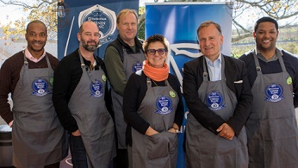
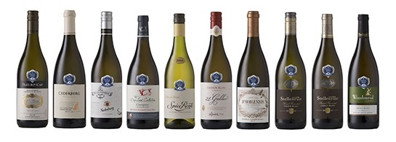
Agenda
Introduction
Vineyards location and age
Cellar practices
Acknowledgments
Notes:
Chenin blanc is the most planted white grape varietal in South Africa and represents 18.6% of plantings in the country. South Africa has more plantings of Chenin blanc than any other wine-producing regions and more than the rest of the world combined..
It is a signature varietal and conversation starter for the South African wine industry and its economic importance to the industry is undisputed. Chenin blanc needs to stay relevant and a lot has been done over the past 15 years to enhance the image and value proposition of this beautiful South African treasure.

Slide 3
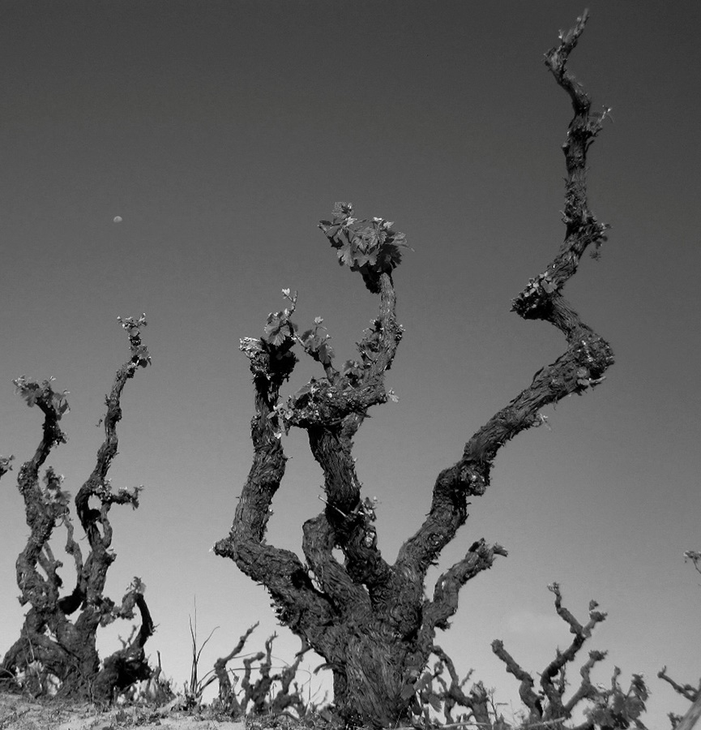
Introduction
Standard bank Chenin blanc Top 10 Challenge
Interviews with winemakers and Viticulturists
Summary of best practices
Practical cellar experiences and observations
Notes:
A review was done of top performing wines in the Standard back Chenin blanc top 10 Challenge of the previous 5 years. Interviews were conducted with winners of 3 or more awards in this period.
Focus was given to vineyard location, age of vines, cellar practices that includes harvest time, grape handling, fermentation, ageing, blending and bottling of wines. The evolution of practices is portrayed against a back drop of climatic conditions like drought, shift in consumer preference and the constant move towards regional excellence.

Slide 4
Vineyards location and age

Slide 5
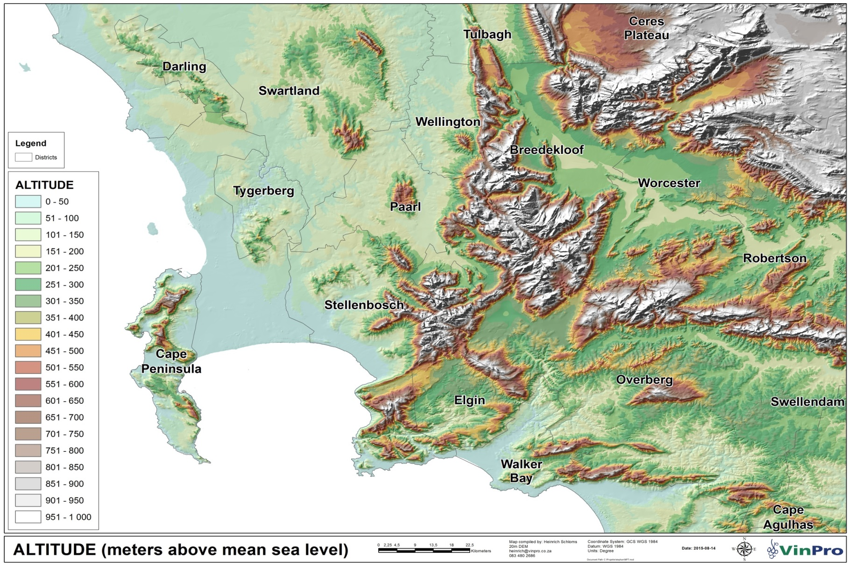
Vineyards location and age
Sea breezes (Proximity to ocean) + Altitude = COOL SUNSHINE
Notes:
Known to acclimate to a variety of conditions, Chenin deftly expresses­ terroir. Cool-climate selections showcase zippy acidity and notes of citrus peel, while those from warmer appellations offer a broader mouth feel and ripe melon or apple characteristics.

Slide 6
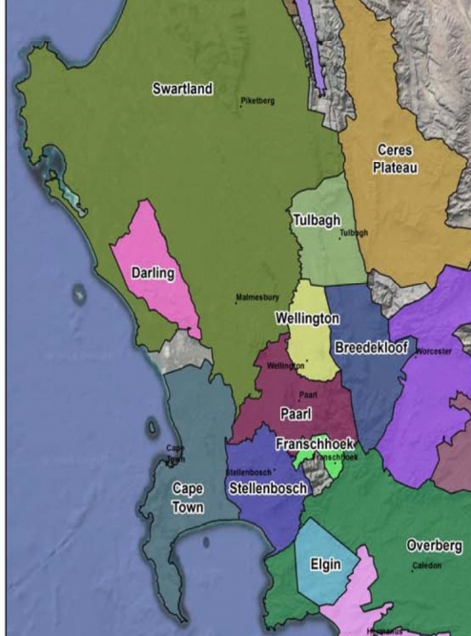
Vineyard location Standard Bank Top 10 Chenin blanc Challenge 2016 -2018
2016
2017
2018
Notes:
Vineyard location for top 10 winners over 3 years.
2016
Majority from Stellenbosch and Paarl
2017
First of dry years and Chenin blanc shaping better from cool sunshine areas, Areas with Altitude of proximity to the cool Atlantic ocean
2018
Altitude from Cederburg, And areas closer to the ocean like overberg, cape town and Stellenbosch
Breedekloof initiative also paying dividends and having a wine in top 10 for first time.
Breedekloof launches Chenin Blanc Initiative
Over the years the Breedekloof Wine Valley has established itself as an area for slow ripening vines. Key to this is the late bud break and long hanging time on the vines. The geography, climate, mountains, rivers and varied geology all contribute to a unique winemaking potential, essentially establishing the area as perfect for producing Chenin Blanc.
Chenin Blanc represents 18% of all South Africa’s vineyards and the Breedekloof Wine Valley has 15% of all Chenin Blanc plantings and supplies 21% or one-fifth of all the wine made from Chenin in South Africa.
The varietal has found its true home in this region, with deep alluvial soils containing smooth river pebbles, which is ideally suited to Chenin Blanc. Chenin Blanc is probably the world’s most versatile variety, ideally suited to many wine styles. This has prompted the Breedekloof winemakers to produce small quantities of Chenin Blanc using innovative winemaking methods and expressing terroirs, especially old vineyards, which has resulted in the Breedekloof Chenin Blanc Initiative.
Nine wineries, all members of the Breedekloof Wine Route, form part of this exciting collaboration, and have all launched a 2014 vintage into the market:

Slide 7
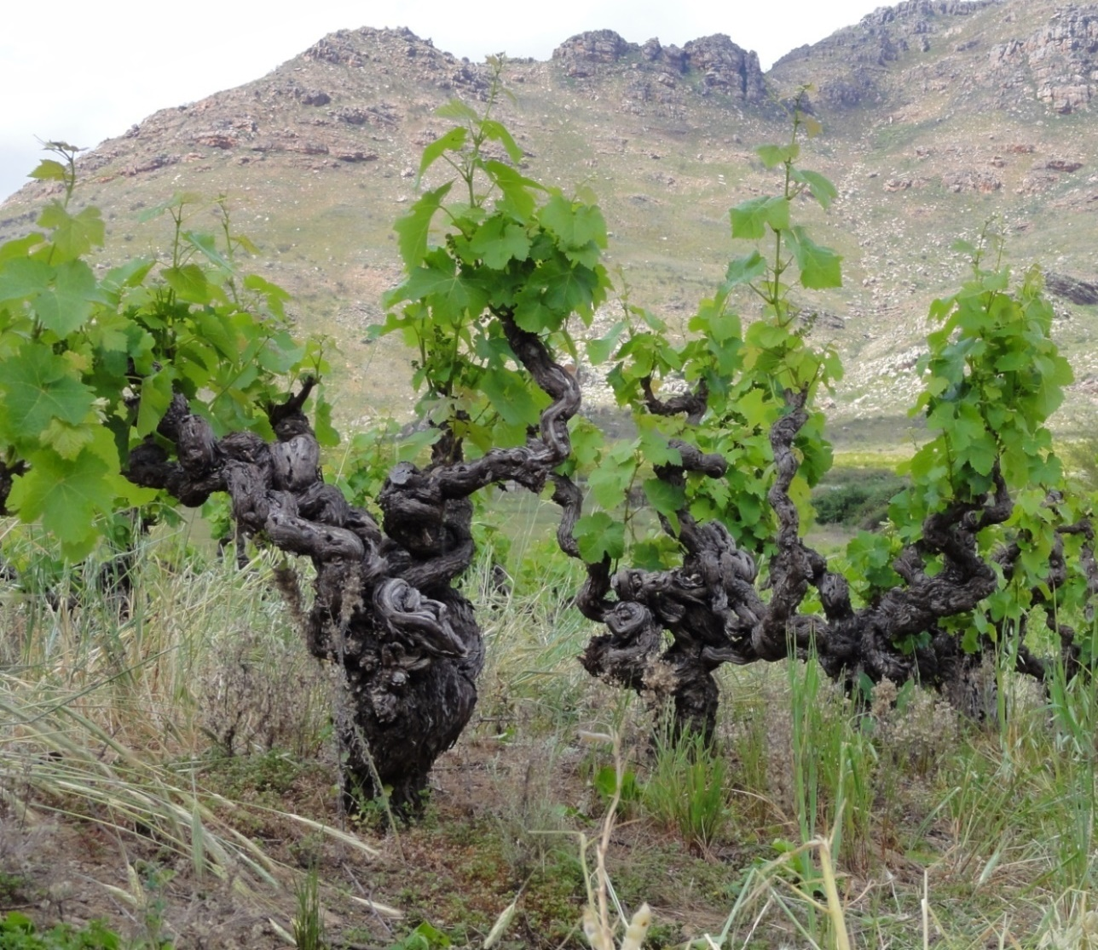
Vineyard age Standard Bank Top 10 Chenin blanc Challenge 2016 -2018
Vineyard age of winners
2016 50% Old Vines
2017 60% Old Vines
2018 90% Old Vines
Some advantages of older vines
Clusters sparse, less fruit
Higher skin berry ratio
Deeper root system
Better resistance against extreme conditions
Notes:
The clusters become sparse, producing less fruit, and the skin-to-pulp ratio increases. This results in berries with more concentrated flavor.
Growers believe old vines have much deeper roots that can reach more mineral deposits and pull more terroir from the earth. In comparison, young vines with shallow roots may suck up more surface water, bloating the grapes and diluting their flavor.
In a drought, the deep root systems may tap into much needed water far below the surface.
Lower yields and concentrated berries produce wines with more structure, intensity, and complexity; on the flip side they might not be as “fruit forward” in style.

Slide 8
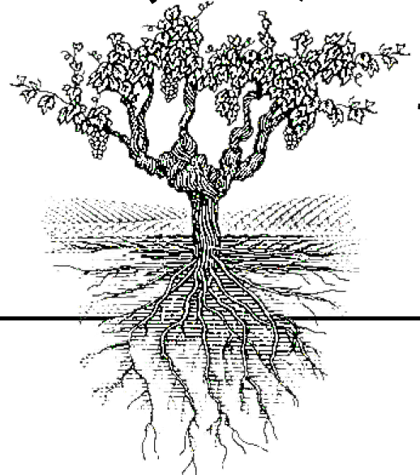
Cellar practices
Fermentation
MLF/Lees Contact
Harvesting
Preparation for bottling
Monitoring of ripeness
Other observations

Slide 9
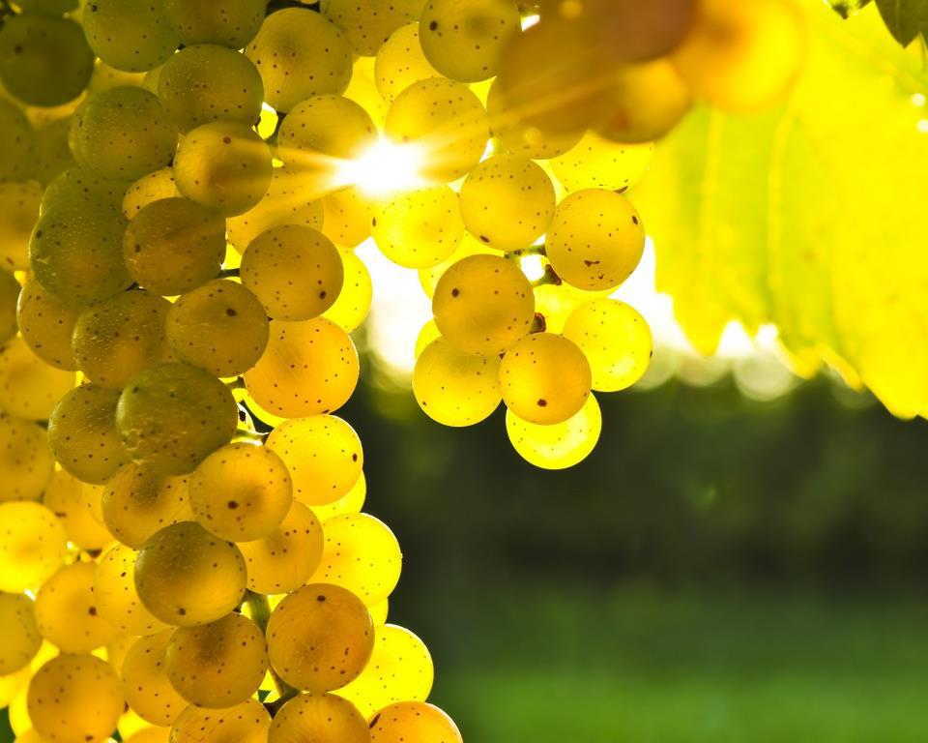
Cellar practices - Monitoring of ripeness
No specific chemical parameters: go on sight, taste
Bunch sampling vs. berry sampling
Infrared imaging
Clonal variation

Slide 10
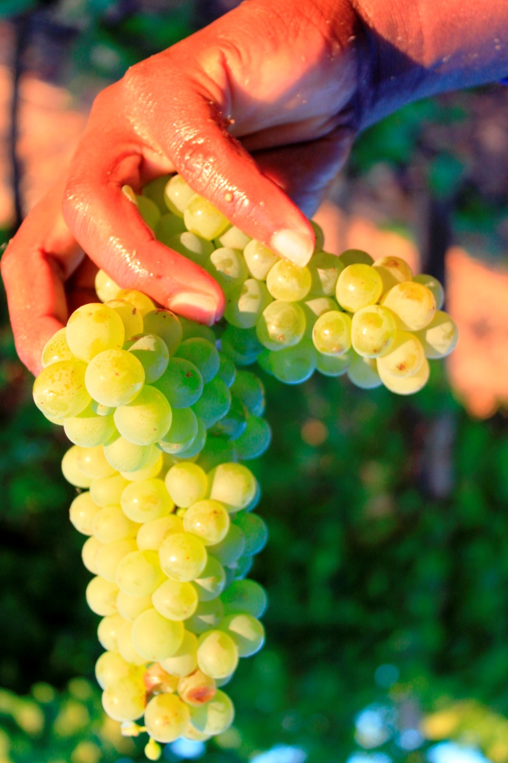
Cellar practices - Harvesting
Up to 3 passes: optimum ripeness
10 – 20 kg lug boxes
100% hand picked
Grapes harvest cool or cooled down
Whole bunch pressed - 24 skin contact
Free run only
Cold settling

Slide 11
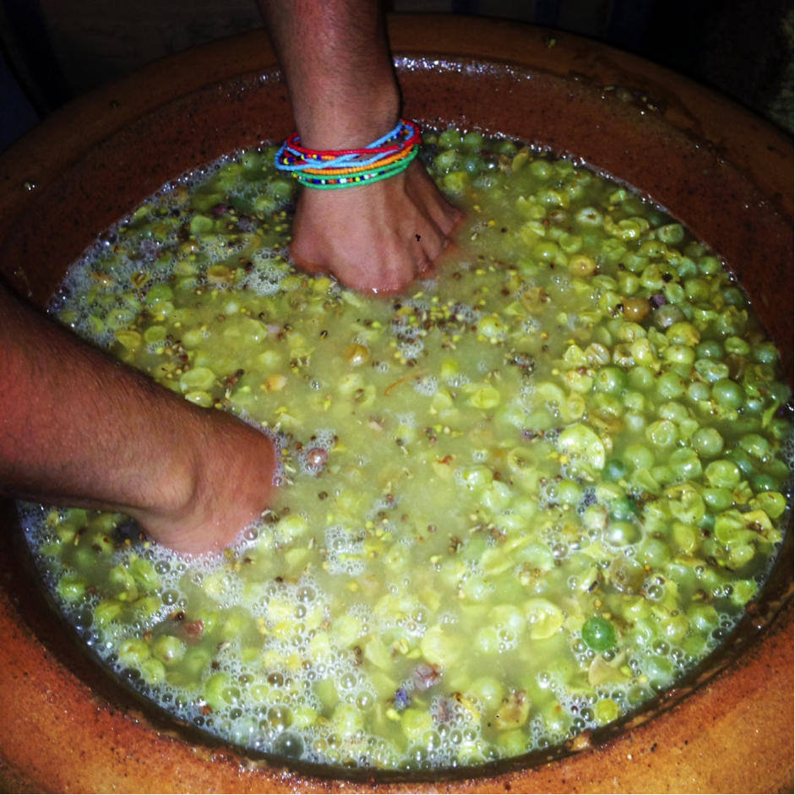
Cellar practices - Fermentation
Creating building blocks
All wines had oak component
Temp: 15-18 $℃$; 18-23 $℃$
Yeast: Natural, inoculated
FO Barrel, 225L, 300L, 500L, 600L, 2500L Foudre, Amphora, Concrete eggs
Older barrels and less new wood contact. Portray sense of place, more texture
Skin fermentation and carbonic maceration used

Slide 12
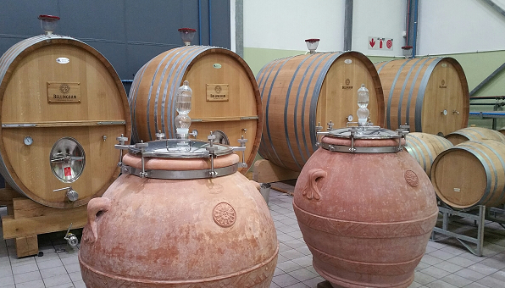
Cellar practices - Fermentation…continue

Slide 13
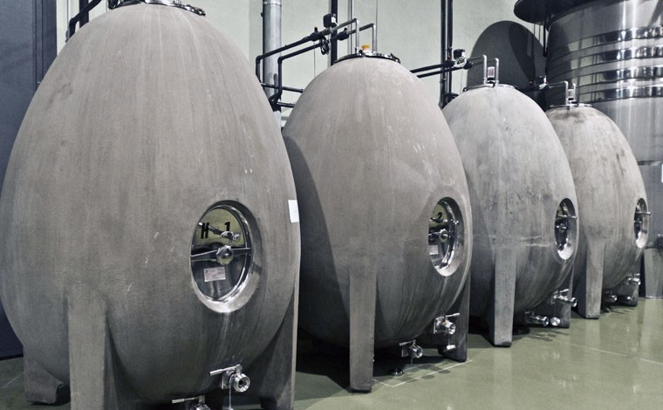
Cellar practices - Fermentation…continue

Slide 14
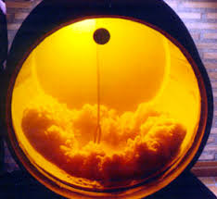
Cellar practices - MLF / Lees contact
All the winning wines – extend lees contact
From 2 – 16 months
Adds mouth feel and complexity
Adds body and structure
Protects fresh fruit
No intentional MLF stimulated

Slide 15
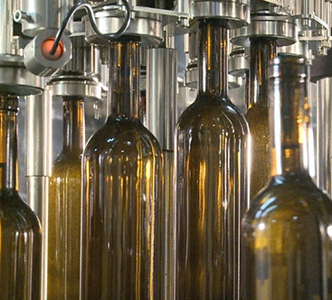
Cellar practices - Preparation for bottling
Minimum finings
Minimum filtration
CMC instead of cold stabilization
Dissolved oxygen monitored
Dissolved CO2 of less than 0.8g/L
Bottled aged for 2-6 months prior to release

Slide 16
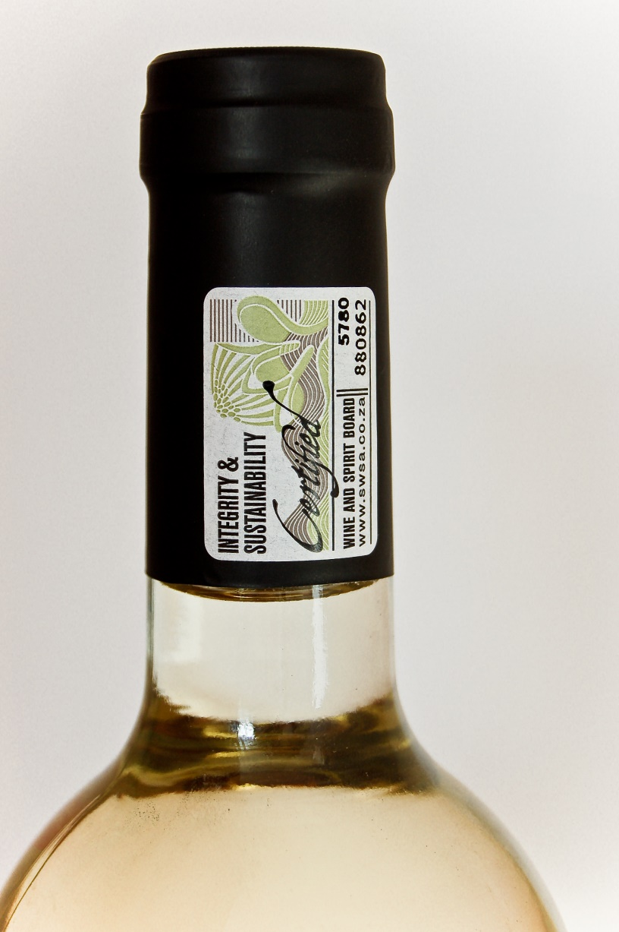
Cellar practices - Final observations
Average price of winning wines increased from R124 (€ 7.75) in 2015 to R200 (€ 12.50) in 2018
Cork and Screw cap
All winners certified by Wine of Origin scheme
Integrity and sustainability seal

Slide 17
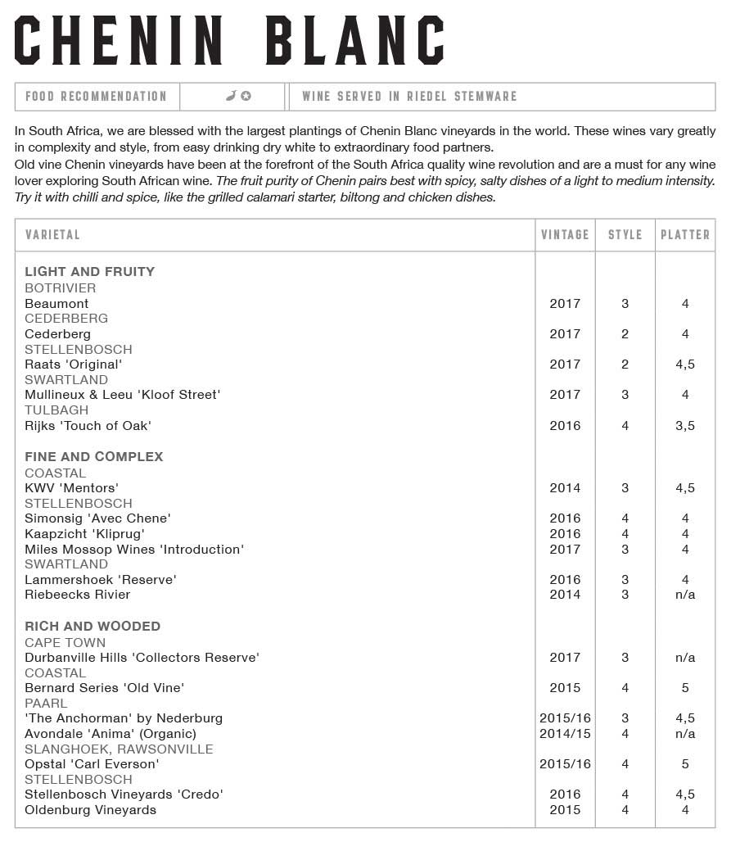
Regional excellence - Wine lists
Notes:
Known to acclimate to a variety of conditions, Chenin deftly expresses­ terroir. Cool-climate selections showcase zippy acidity and notes of citrus peel, while those from warmer appellations offer a broader mouth feel and ripe melon or apple characteristics.

Slide 18
Acknowledgements
Ina Smith – Chenin blanc Association
Dr H Nieuwoudt - University of Stellenbosch
Maps – Vinpro
Photos - WOSA
Telephonic interviews with various winemakers and viticulturists

